Slide 1
Personality (part 2)
Renee El-Krab, MS (She/her)
relkrab@ric.edu

Slide 2
Quiz
Take out a paper and put your name at the top

Slide 3
What type of medication is typically used to treat people with mood swings, aggression, and impulsivity?
Antidepressants
Anti-psychotic medication
Anti-anxiety medication
Mood Stabilizers

Slide 4
What is the most common type of therapy to treat personality disorders?
Dialectical Behavioral Therapy
Cognitive Behavioral Therapy
Motivational Interviewing
Mindfulness-Based Stress Reduction

Slide 5
Avoidant Personality Disorder, Dependent Personality Disorder, and Obsessive-Compulsive Personality Disorder are all part of which cluster?
Cluster A – Eccentric/Odd
Cluster B – Erratic/Dramatic
Cluster C – Fearful/Anxious

Slide 6
Personality “Types”

Slide 7
Personality Types: Type A
Positive Characteristics
Achievement Oriented
Hard working
Negative Characteristics
Perfectionistic
“Workaholics”
Self-confident
Determined
Unfriendly
Aggressive
Competitive
Lateef et al., 2019

Slide 8
Personality Types: Type B
Positive Characteristics
Easy-going
Negative Characteristics
Avoids hard work
Procrastinate
Social
Patient
Relaxed
Lateef et al., 2019

Slide 9
Personality Types: Type C
Positive Characteristics
Patient
Cooperative
High control over emotional responses
Negative Characteristics
People pleasers
Sense of helplessness
Inability to recognize and verbalize negative emotions
High stress levels
Rymarkzyk et al., 2020
Notes:
Rymarczyk K, Turbacz A, Strus W, Cieciuch J. Type C Personality: Conceptual Refinement and Preliminary Operationalization. Front Psychol. 2020 Sep 16;11:552740. doi: 10.3389/fpsyg.2020.552740. PMID: 33041918; PMCID: PMC7525034.

Slide 10
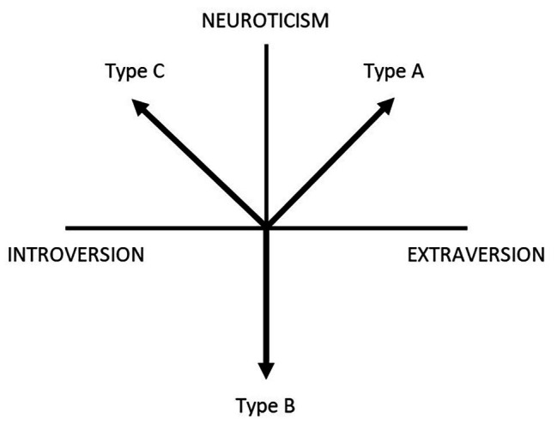
Rymarkzyk et al., 2020

Slide 11
Personality Type: Type D
Positive Characteristics
Negative Characteristics
Honest
Hardworking
Detail Oriented
Low confidence
Lonely
Highly sensitive to rejection
Pessimistic
Distressed & worried

Slide 12
Personality Types and The 5 Factor Model
Type A tends to be high in conscientiousness and extraversion – low in agreeableness
Type B tends to be high in openness and agreeableness – low in neuroticism
Type C tends to be high in agreeableness and neuroticism - low in extraversion
Type D tends to be high in neuroticism and low in extraversion
Notes:
Ramanaiah, N. V., Sharpe, J. P., & Byravan, A. (1997). Type A behavior and the five-factor model of personality. Psychological Reports, 81(2), 368-370.
De Fruyt, F., & Denollet, J. (2002). Type D personality: A five-factor model perspective. Psychology and Health, 17(5), 671-683.
Rymarczyk K, Turbacz A, Strus W, Cieciuch J. Type C Personality: Conceptual Refinement and Preliminary Operationalization. Front Psychol. 2020 Sep 16;11:552740. doi: 10.3389/fpsyg.2020.552740. PMID: 33041918; PMCID: PMC7525034.

Slide 13
Outcomes
Academic/Work Performance
Type A and C have higher academic achievement
Type A perform well in stressful work conditions – but run into more interpersonal challenges
Type B does better at managing a work-life balance
Also better at coping with stressful work conditions, making them better higher-level positions
Health Outcomes
Type B tend to be the healthiest and have the highest emotional intelligence
Type A and D have been associated with cardiovascular disease
Type C has been associated with cancer
Psychoneuroimmunology
Let’s think about why
Notes:
Poropat, A. E. (2009). A meta-analysis of the five-factor model of personality and academic performance. Psychological Bulletin, 135(2), 322–338. https://doi.org/10.1037/a0014996
Garavan, T., Srivastava, S., Madan, P., O’Brien, F., & Matthews‐Smith, G. (2022). Type A/B personality, work–family, and family–work conflict: The moderating effects of emotional intelligence. Human Resource Development Quarterly, 33(3), 223–247. https://doi.org/10.1002/hrdq.21454

Slide 14
Questions?

